Slide 1




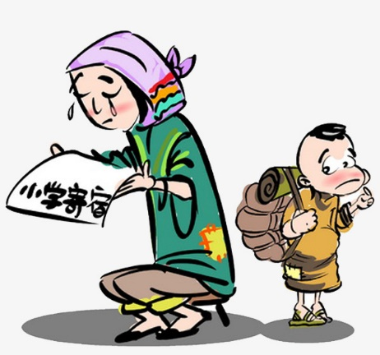
Users Roster
Event Reports & Statistics
Participants
Referrals
Advertisement
Donations
Inventory
Memorandum of Agreement
Linkage’s Profile
Event Schedules & Reports
Communities Roster
Advertisement
Departmental Information
Approvals
Event Schedules
Budget Plan
Company Information
Personal Information
Event Proposals & Sponsorships
Referrals
Donations
Re-COP/Admin
Linkages
Personal Profile
Communities & Linkages Roster
Event Schedules
Beneficiary Profile
Donations
Recoletos Community Outreach Program Community Extension Website
Organizational Information
Personal Information
Referrals
Participations & Evaluations
Donations
Community Information
Event Participants
Communities
Volunteers

